Slide 1
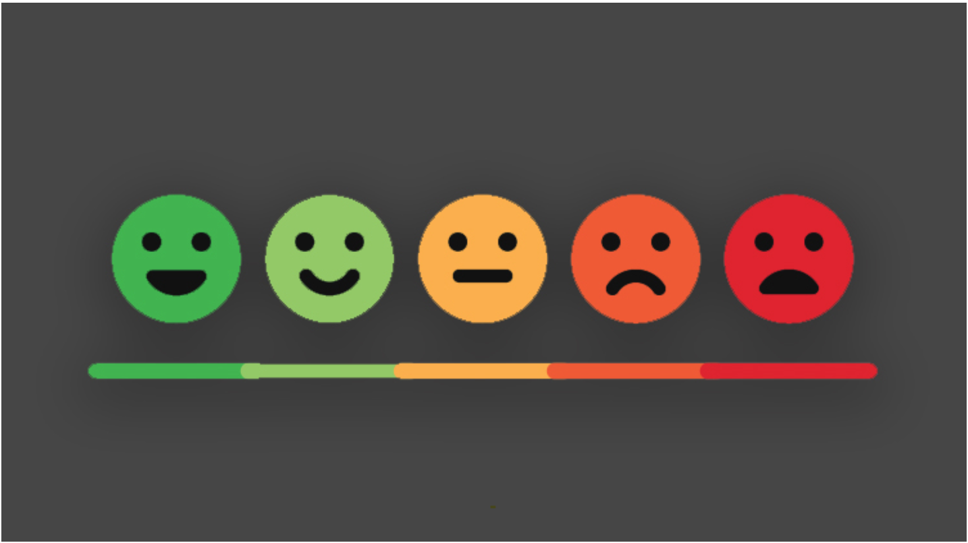
Sentiment Analysis
By Steve Newman
June 30, 2020

Slide 2


Brand Reputation
Consumers will read on average 10 product reviews before making a purchase
Increase brand loyalty
Position as leader in the market

Slide 3
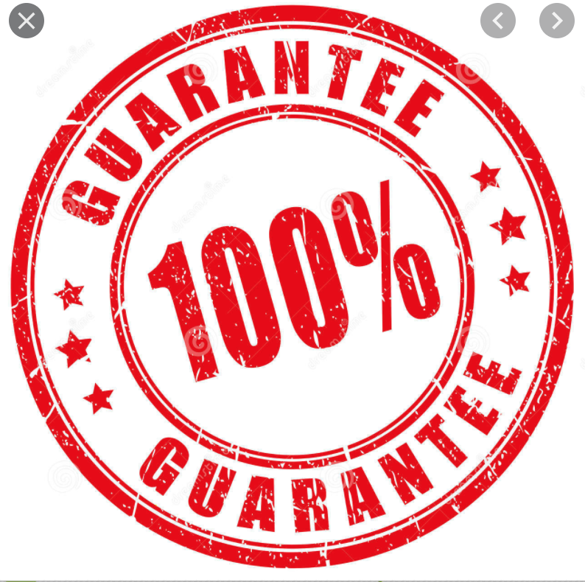
Manage Negative Feedback
Improve:
Product
Customer relationship management
Manage potential customers brand impression

Slide 4
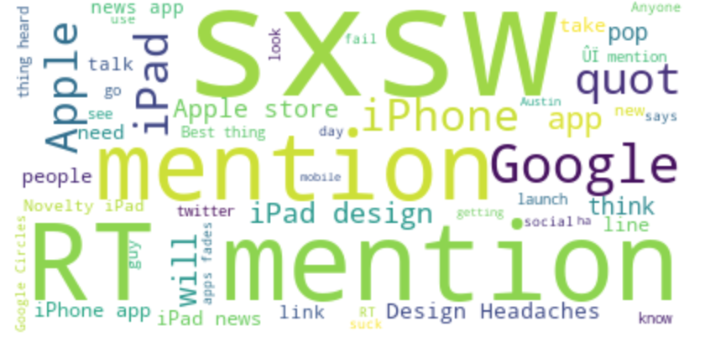
Identify Sentiment
Natural Language Processing (NLP)
Test various models
Adjust data for imbalance
Optimize model parameters

Slide 5

Results
Random Forest Classifier
Under sampling
Recall Metric - .80
Negative reviews identified out of all reviews

Slide 6
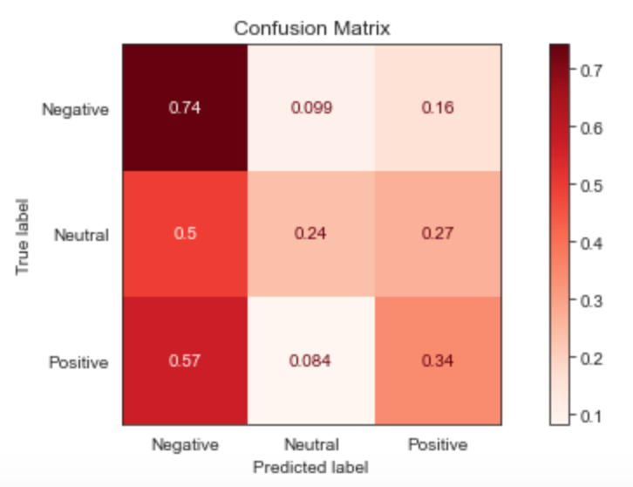
Results
O

Slide 7
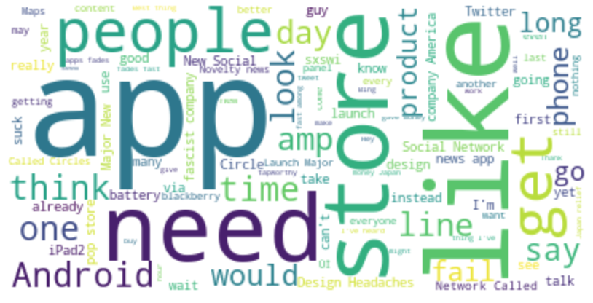
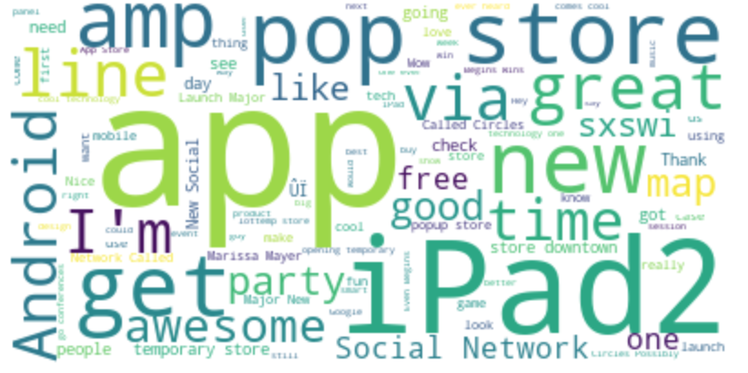
Examples
Negative Sentiment Words
Positive Sentiment Words

Slide 8

Example Tweets
".@wesley83 I have a 3G iPhone. After 3 hrs tweeting at #RISE_Austin, it was dead! I need to upgrade. Plugin stations at #SXSW."
"@sxsw I hope this year's festival isn't as crashy as this year's iPhone app. #sxsw"
"@mention - False Alarm: Google Circles Not Coming NowÛÒand Probably Not Ever? - {link} #Google #Circles #Social #SXSW"

Slide 9
Recommendations
“… I have a 3G iPhone. After 3 hrs tweeting at #RISE_Austin, it was dead! I need to upgrade...”
Respond to customers addressing feedback
“We are sorry about your experience, iPhones need battery replacement every couple of years.”
Share sentiment with product managers
Improve battery active time.
Promote campaign with improvements made
Social Media advertisements of longer lasting battery.

Slide 10
Future Work
Develop text generative bots to respond to customer feedback
Optimize model to identify positive, neutral, and negative sentiments with high accuracy
Apply models to other platforms

Slide 11
Thank you!
I welcome any questions you may have!

